Slide 1
Driving Toward Outcomes
Advanced Energy Group Washington
21Q4 Mobility and Transportation Stakeholder Challenge
Nekabari L. Goka
Manager, Strategic Initiatives – Utility of the Future
Pepco Holdings

Slide 2
Pepco’s Climate Solutions Plan – supporting the District’s climate and clean energy goals
Electrifying Transportation Portfolio
1
Connect Transportation Initiative
Make-ready across every segment – at home and around town
Key Corridors Charging
Residential Charging
Multi-Unit Dwelling Charging
EV-Ready System Design and Engineering
Vehicle-to-Grid Demonstration
Food Truck Service Electrification
Destination Charging
Rideshare & Taxi Charging Hubs
Transit Bus Charging
2
Smart Rates Transportation Initiative
Enabling the deployment of all classes of electric vehicles
Residential Electric Vehicle Charging Time-of-Use Rate
Demand Charge Solution
Transit Bus Rate Solutions

Slide 3
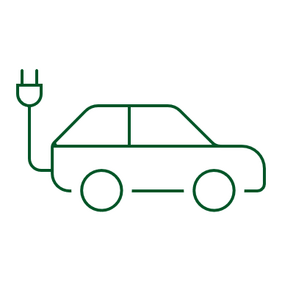
The Electric Slide – the role of the utility in transition
Managed EV Charging
Local Solar
Pepco’s role continues to be centered around delivering safe, reliable, sustainable and affordable electric service for customers across the District
This role has expanded to include helping facilitate the achievement of broader policy objectives related to energy use and climate change, equitably, affordably and inclusively
As the connector of customers and energy technologies, Pepco aims to optimize future grid operations while simultaneously driving deep decarbonization across the District
Renewable Energy
Interactive Grid
Energy Efficiency
Battery Storage
Active Load Management
Building Electrification

Slide 4
Incentive Alignment – focusing on the importance of outcomes
Electrifying Transportation
Pepco’s programs enable GHG abatement by readying the District for vehicle electrification and enabling smart charging
Focus on balancing a range of market considerations for the utility, technology providers, policymakers, and customers
Importance of incentive alignment is magnified in the context electrification of the transportation sector at scale

Slide 5
Driving Toward Outcomes - what getting it right looks like
Interactivity
Incentivizing smart EV chargers that communicate data via cloud
Expanding the universe of utility supported solutions that can be leveraged to achieve transportation focused climate objectives
Closing the incentive misalignment gap that favors short term solutions over long term optimal outcomes
Balancing the customer and grid level considerations to optimize for the customer and grid of the future
Electrifying Transportation
Guiding Principles Advanced
Equity & Inclusivity
Affordability
Promoting equitable distribution of charging infrastructure through targeted and right-sized incentive programs
Developing rate designs that enhance the business case and economics for EV charging
Reliability
Sustainability
Data sharing and demand response programs that enhance system reliability
Driving EV adoption across that significantly decreases carbon emissions

Slide 6
Regarding Mobility & Transportation, to achieve Washington's Carbon & Equity goals, a critical obstacle for Pepco to overcome is right sizing transportation electrification programs to optimize for the customer and grid of the future.

