Slide 1
Clearway Energy Inc.
Private Equity Sponsor
$48 Billion available investment capital
$46 Billion in portfolio revenue from 18 portfolio companies
53,000 portfolio company employees
Our Company
7GW Energy Generation
Top 10 owner of Solar, Wind, and District Energy
Publicly Traded on NYSE
Our Organization
Owner and operator of District Energy, Central Plant, and CHP systems
Recent Design/Build experience
Clearway Energy Thermal Systems and Offices
San Francisco, CA | San Diego, CA
Tulare, CA | Tucson, AZ
Tempe, AZ | Phoenix, AZ
Houston, TX | Omaha, NE
Minneapolis, MN | Harrisburg, PA
Pittsburgh, PA | Dover, DE
Plainsboro, NJ | Princeton, NJ
Bridgeport, CT | Caguas, Puerto Rico
●
●
●
●
●
●
●
●
●
●
●
●
●
●
●
●

Slide 2
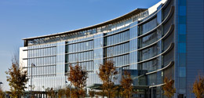
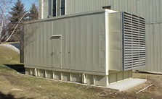
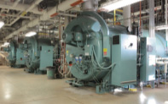
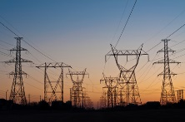
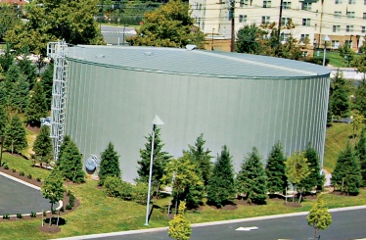
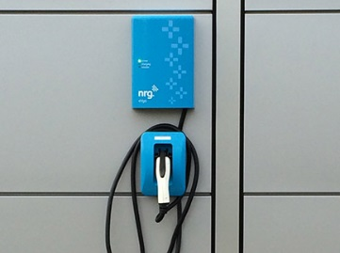
Clearway micro-grid solution for Princeton Hospital
Princeton Hospital
CHP
Backup generation
4.6MW natural gas plant supplies 100% of heating & cooling needs and most of the electrical needs
Enterprise Energy Management
With the grid down, the 3 back-up generators can support the hospitals essential power needs
Chillers
Grid
Thermal Storage
Solar
Three 1,000-ton electric chillers and one 700-ton absorption chiller provide chilled water
Can draw power from or export to the PJM power grid
1.2 M gallon chilled water storage for cooling the hospital
200kW Solar Array provides electricity and shaded parking
Two 30 amp electric vehicle charging stations
Notes:
NRG Thermal was responsible for design, construction, start-up and supplying all of the equipment for this project, and is currently responsible for on-going operations. The recovered thermal energy is used to heat and cool the medical center and the steam is also used for sterilization, not just cooling. We also installed a million gallon tank to store chilled water in and we use the excess thermal energy at night to cool the water in the tank and then pump it to the hospital during the daytime to help meet the peak loads.
Princeton Hospital:
NRG’s Reference Case Micro-grid
Project Overview
Primary and back up energy generation
Elegantly controlled to minimize cost and maximize reliability
Powered by diverse hydrocarbon fuels and the sun
Supplemented by an advanced thermal storage system
Providing all energy needs—heating, cooling, and electricity
Synchronized with PJM or totally independent of the grid
Serving a state-of-the-art, critical-care facility
Besides being able to draw power from the grid, NRG can export to the grid as well - A “2-way” street (import and export) provides more value to the client.
In addition to being responsible for design, construction, and start-up, NRG financed the whole works.
Besides providing operations services, NRG actually “owns” the assets. NRG also maintains them – getting assets off the client’s balance sheet and, in this case, onto our balance can be a giant positive.
_____________________________________________________________________________
Combined Heat and Power (CHP) Plant - The hospital is be powered by a 4.6 megawatt natural gas-fired CHP plant, developed in partnership with NRG Energy, Inc., a Princeton based energy company. By producing electricity and heat from a single-fuel source, CHP is up to twice as efficient as a traditional electric generation system that produces heat and power separately.
Solar Power - Known as solar groves, the solar cells convert sunlight directly into electricity. The 15 panels placed over a portion of the hospital's parking lot produce energy equivalent to what would be needed to power 30 average sized single family homes. Developed in partnership with NRG Energy.
Thermal Energy Storage - By producing and storing chilled water at night, and using it to cool the hospital when needed, the hospital removes thousands of kilowatt hours of demand from the power grid during periods of peak demand, as well as reduces energy costs.
Hospital building, CHP plant and solar are actual photos of the Princeton Hospital site.
http://www.princetonhcs.org/phcs-home/whats-happening/phcs-news--information/phcs-news.aspx/d=3743/title=topping-out-ceremony-marks-milestone-in-construction-of-umcpp---major-energy-efficiency-grant-by-pseg-also-announced--
The new hospital opened in May 2012, and is one of the most sustainable in New Jersey and the country. A major component of the green design is the power generation elements that include on-site co-generation plant supplying 100 percent of the hospital's heating and cooling needs a chilled water thermal energy storage system, and a photovoltaic installation. Princeton-based power corporation NRG Energy is partnering with UMCPP in the development of this green power system. Other sustainable features include solar shades, sustainable construction materials and finishes, water-saving fixtures. Indigenous landscaping, environmental control systems, east-west building orientation, and 100 percent fresh air in patient rooms.
http://www.princetonhcs.org/phcs-home/whats-happening/phcs-news--information/phcs-news.aspx/d=5208/title=phcs-president-and-ceo-barry-rabner-receives-plansmart-nj-award
Scope and Sophistication
For NRG Thermal, the project is probably the most sophisticated CHP project it has undertaken. It provides the ability to tie together systems producing electricity, steam heating and chilled water for air conditioning, according to Bob Henry, senior vice president of NRG Energy, the parent of NRG Thermal, one of the largest providers of combined heat and power plants in the nation.
The Minneapolis-based company typically provides systems for heating or for cooling -- or for both, as in the case of PNC Park, the home of the Pittsburgh Pirates. Under the original plans for the hospital, the facility was seeking a heating and cooling system, but NRG convinced it to include turbine-producing electricity as well.
With three systems capable of providing the electricity the facility will need, there is also the option of exporting power to the regional electric grid at times, or, importing electricity from the grid into the facility when power prices on the grid are dropping.
Efficiency a Key
CHP plants have the attraction of being much more efficient than conventional power generating stations, which have an efficiency rating of about 35 percent, while CHP plants typically are 60 percent to 65 percent efficient, according to Gary Gustafson, director of engineering for NRG Thermal.
It is one of the reasons the current New Jersey Energy Master Plan envisions building up to 1,500 megawatts of new CHP plant generation by the year 2020. One megawatt is enough to power about 800 homes. The state had set aside $158 million to help build new CHP plants, but the Christie administration diverted that money to help balance the budget.
http://www.youtube.com/watch?v=780WzoitUqQ

