Slide 1

CREF 2018: ISLAND RESILIENCY ACTION CHALLENGE
David Gumbs
Dagmara Avanindra
Chris Burgess
Patrick Drijvers
Jason Robinson

Slide 2
Table of Contents
1
Background & identification of critical infrastructure
2
Safeguard I: Undergrounding
3
Safeguard II: Distributed Generation
4
Safeguard III: Micro Grids
5
Safeguard IV: Human Resiliency

Slide 3
2018 Winning Problem Statement
Determining where to invest scarce human & capital resources while improving, reliability, effective emergency response and driving a new economy transition David Gumbs, CEO ANGLEC
Critical infrastructure is the physical assets that are so vital that their incapacity or destruction would have a debilitating impact on our physical or economic security or public health or safety.
(Source. US Homeland Security)

Slide 4
Critical Infrastructure Assessment ($231M)
Utilities
Health
Economic
Electricity
  1 Gen. Plant: Op Cap. 23MW
  2 Substations
  T&D 150 miles
  Poles 9,500
  Underground 3 miles
Telecom
  2 Major providers (1 Lan)
  40 Comm. Towers
  1 Submarine Cable
1 Water RO Plant
2 Fuel Depots
1 Major Hospital (+1 small private)
4 Regional Clinics
1 Dental (4 priv. practices)
Tourism Corridor (Mix of 10 hotels, rests, villas, etc.)
5 Major Hotels
2 Banks
Security
Education
1 Police Station
1 Prison
1 Court House
3 Government Buildings
6 Primary Schools
1 High School
1 Private School
Other
Transportation
6 Major Grocery Stores
~9,500 Households & Businesses
2 Sea Ports
1 Airport

Slide 5

Safeguard 1: Undergrounding

Slide 6
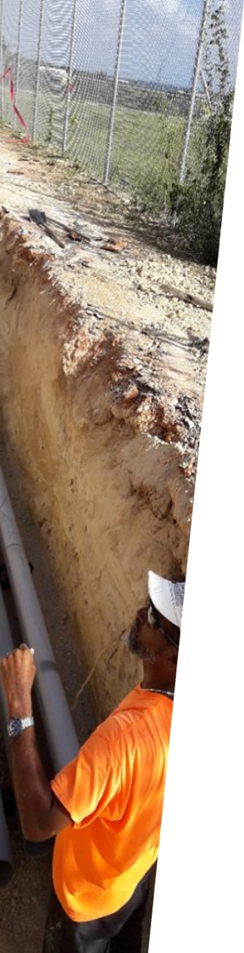
Prioritizing Critical Resources: Underground Grid
Assumptions
Covers all 7 main feeders (excluding spur-lines)
Findings
Project Cost: ~$140,000,000
Duration with 100% Financing: 5 years
Duration @ 6,000 meters/yr: 15 years
Length of HV Assessed: 85,000 meters
Cost at @ 6k meters/yr: $10m /year
Financing
Utility via Tariff, CDB [financing], Limited opportunities (EU, UK, etc.), JV with TELECOM, CTV & Water.

Slide 7
Safeguard 2: Distributed Generation

Slide 8

Distributed Generation: Solar PV
Summary of Findings
Households
Estimate 9,000 households (500W to 2.4kW): US$48.4M
Installed cost per home @2.4kW: US$12.5k ($5.10/W)
@ Blocks of 100: $1,248,000 (2400w x 100 x $5.10)
Average household cost across all size installations: : $5,500
Funding Strategy
USAID Development Credit Authority (DCA) via Republic Bank, CDB, Utility Solar Lease Program, PPA, Mortgage Solar Loans and Refinancing with Equity for Solar Program

Slide 9
Distributed Generation: Solar PV
Summary of Findings
Floating Solar PV
5 MW located in Tourism Corridor: US$11M
14 MW located in Tourism Corridor: US$30M
PPA estimated at $0.17-$0.22 /kWh
* Inclusive of 1.5MWH (4HR) battery storage
Microgrids
22 Locations @ Tourism Corridor @ 1.2 MW: US$4.5M
130 Locations @ Small Commercial @ 1 MW: US$4.0M
6 Locations @ Large Commercial @ 6 MW: US$22.0M
7 Locations @ Small Commercial @ 500kW: US$1.4M

Slide 10
Human Resiliency

Slide 11

Human Resiliency
Man never made any material as resilient as human spirit
- Bernard Williams

Slide 12
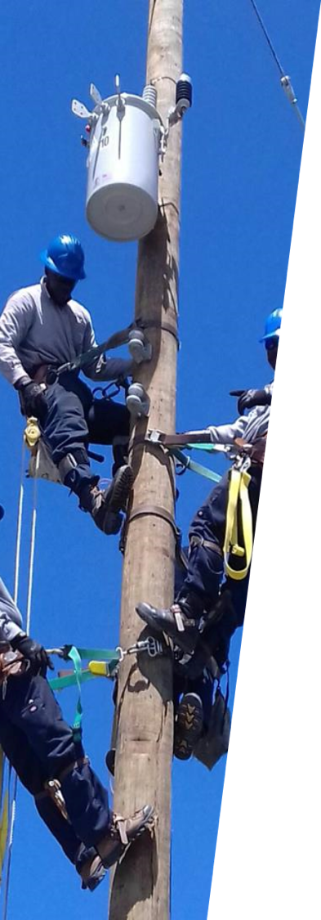
Human Resiliency – Capacity Building
TECHNICAL CAPACITY - CARILEC
BASIC NEEDS – K1
Capacity Building for Technical Staff
Objective: Efficient platform to increase access to capacity building among members, increase connectivity & knowledge sharing
Implementation:
Online platform with various trainings across the Caribbean
Online groups: WhatsApp and LinkedIn
Webinars: undergrounding, distributed solar, microgrids, succession building, tenders, PPAs, etc.
Cost: $6.000 per month for program management
Capacity Building for Basic Needs
Objective: Enable resilience and agility of staff to empower them for grid restoration
Medical Response: through WIEMS (Windward Island Emergency Med Services)
CPR/First Aid 2-day Program: $150pp
Emergency Med Responders: $400pp
Psychological Agility: through INSPIRED and Red Cross
Psychological Agility: $500 per group
Extensive Medical Response & Psychological Agility through UN and World Food Program: $10,000 - $20,000

Slide 13
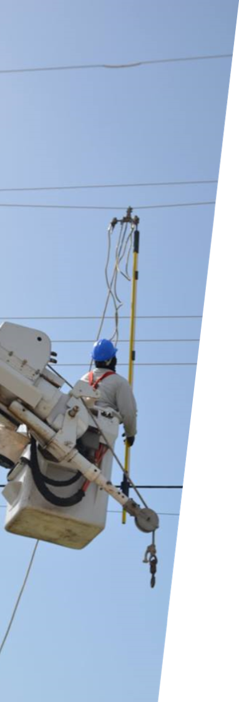
Human Resiliency – Emergency Response
Primary Needs
Technical Restoration
Hurricane Recovery Costs
RED CROSS
PAHO – Pan American Health Organization
WHO – World Health Organization
CDAP – CARILEC Disaster Assistance Program ($75,000 - $125,000)
CSSF – Conflict Security Stability Fund ($1,600,000 across 70 countries yearly)
CCRIF – Caribbean Catastrophic Risk Insurance Facility
CAT 5: $2,000,000 USD
for 6 teams, 7 months
CAT 4: $900,000 USD
for 6 teams, 3 months
CAT 3: $360,000 USD
for 6 teams, 1 month

Slide 14
Thank You!!!
David Gumbs
david@daavisolutions.com
Dagmara Avanindra
dagmara@davaenergy.com
Chris Burgess
cburgess.contractor@rmi.org
Patrick Drijvers
drijvers.patrick@nvgebe.com
Jason Robinson
jason@solarbuzzjamaica.com

Slide 15
Additional Information
APPENDIXES

Slide 16
Appendix 1: Infrastructure Assessment

Slide 17
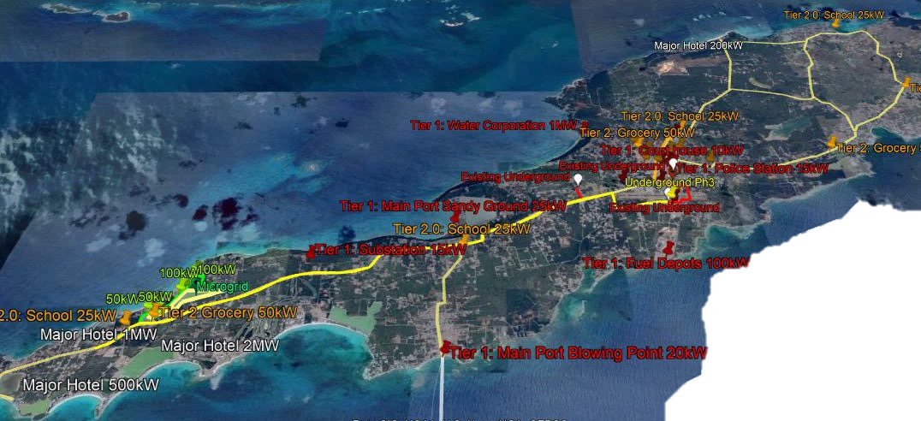
Arial View of Critical Infrastructure

Slide 18
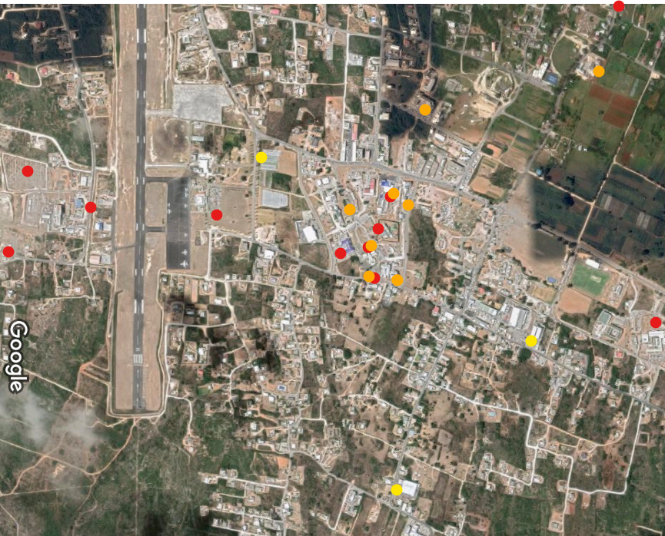
Ariel Infrastructure Dispersion Map
Tier 1 Infrastructure
Power Plant
Solar Farm
Fuel Depot
Airport
Police Station
Prison
Hospital
Tier 2 Infrastructure
ANGLEC Main Office
Schools
Court House
Telecom Services
Banks (2)
Government Offices
Zone 1
Valley
Central
Tier 3 Infrastructure
Grocery Stores

Slide 19
Critical Infrastructure Assessment Detail

Slide 20
Appendix: Distributed Generation

Slide 21
Distributed Cost Assessment (1)

Slide 22
Distributed Cost Assessment (2)

Slide 23
Distributed Cost Assessment (3)

Slide 24
Exploration of a Tourism Corridor

Slide 25
Appendix 2: Undergrounding

Slide 26
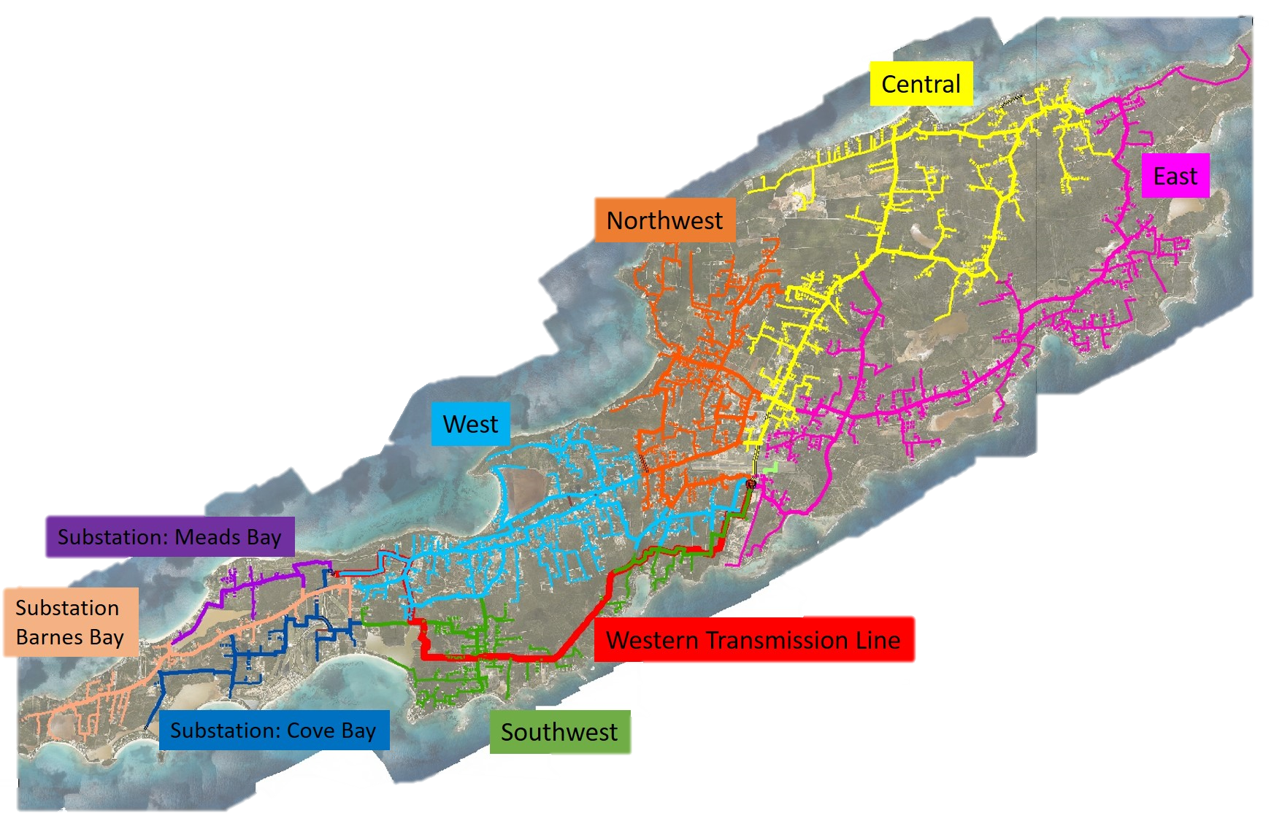
Existing Grid

Slide 28
Appendix 3: Distributed Generation

Slide 29

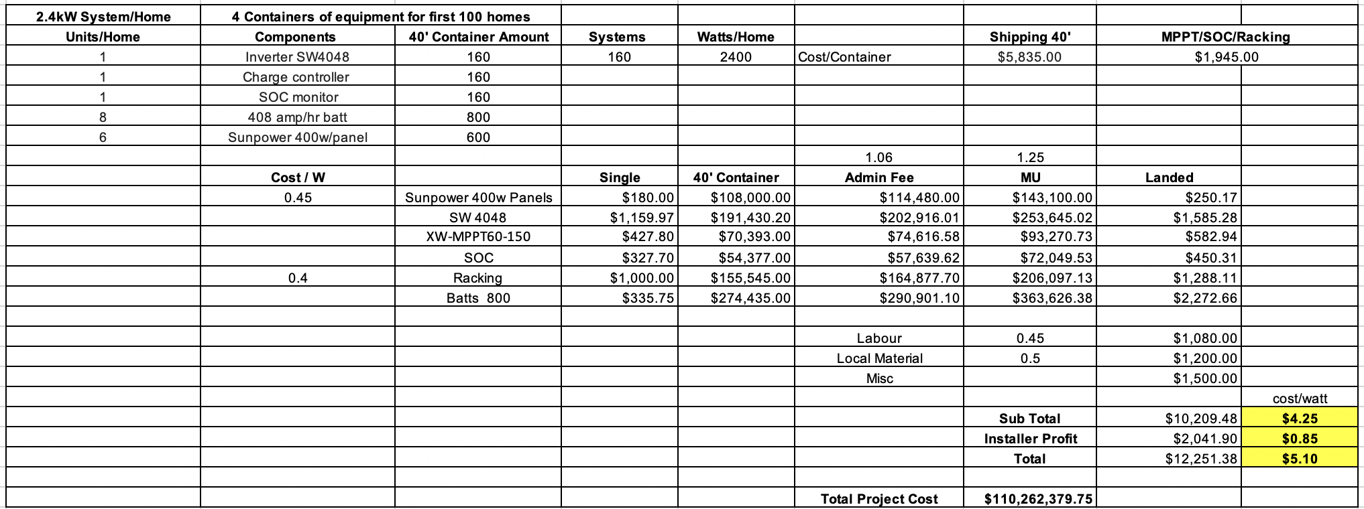
Appendix Distributed Solar Costs

Slide 30
Distributed Generation: Solar PV
Funding Strategy
Partner with Republic Bank and other funding sources such as CDB & USAID Development Credit Authority (DCA)
Utility solar lease, install and own program
PPA with Utility
Run homeowner resiliency programs promoting solar + storage (cap @ 2.4kW
DCA: Partial credit guarantee designed to reduce risk to generate additional lending to underserved markets.
Republic Bank mortgage solar loans and refinancing with equity for solar.

Slide 31
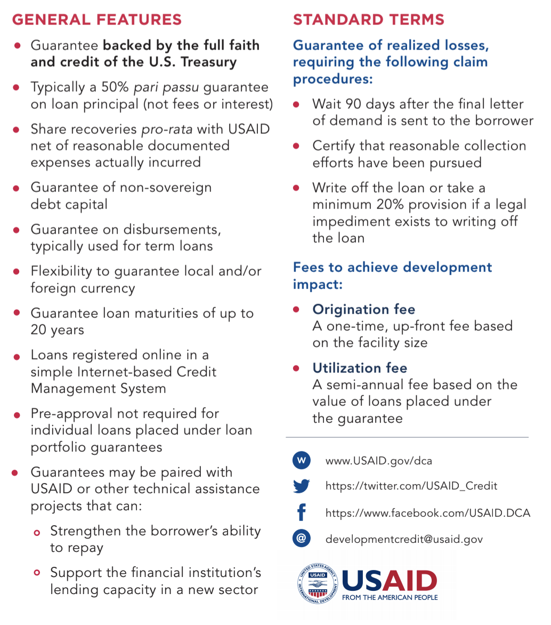
Appendix Development Credit Authority (DCA)

Slide 32
Appendix 4: Microgrids

Slide 33
Distributed Generation: Other Explored Options
Tourism Corridor Microgrid

Slide 34
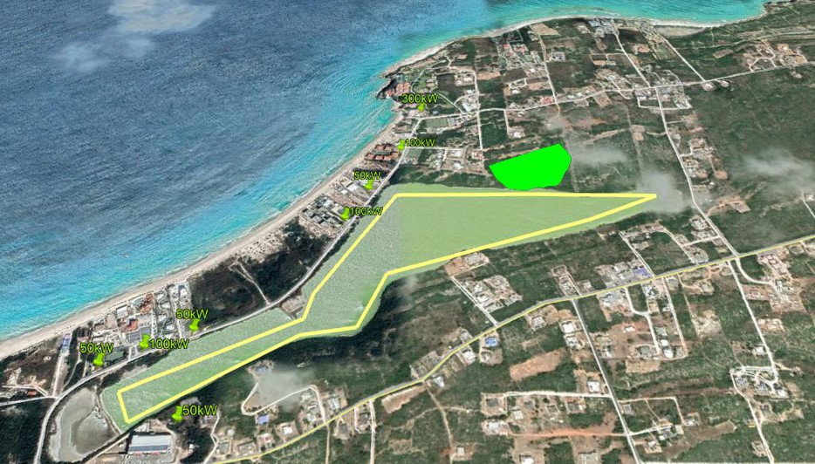
Exploration of a Tourism Corridor

Slide 35
Appendix 5: Human Resiliency

Slide 36
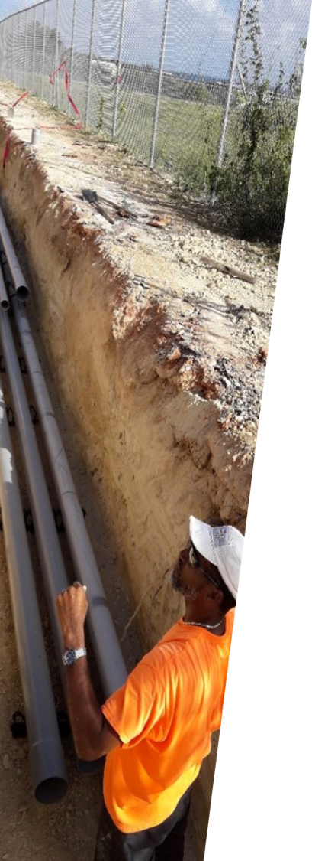
T&D Emergency Restoration Costs
Item | Cost
Food | $30/day
Lodging | $75/day
Daily wage – 10 hr work day | $200/day
Round-trip per linesman | $750
Tools transport. per linesman | $500
Truck transportation | $10,000
Digger transportation | $10,000
Cost per crew per rotation (5 ppl per crew, 4 weeks per rotation) | $44,950
CAT 5: 30 linesman, 7 months | $2,000,000
CAT4: 30 linesman, 3 months | $900,000
CAT3: 30 linesman, 1 month | $360,000

