Slide 1
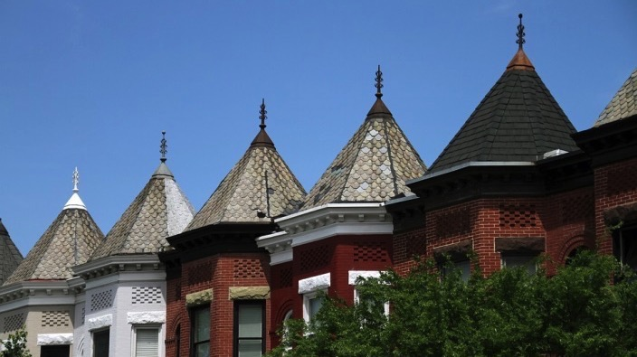
@Resilient_DC

Slide 2
The world is in trouble.
Notes:
The world is at risk, in ways we’ve never seen before.

Slide 3
3
Flooding in Houston, Texas
Notes:
Floods…(by the way Harvey was Houston’s third 500-year storm in three years.)

Slide 4
4
I-35W Mississippi River bridge collapse in Minneapolis, USA
Notes:
Aging infrastructure.

Slide 5
5
Health officials taking temperatures of passengers arriving at the Nairobi airport, Kenya
Notes:
Public Health Emergencies and Pandemics

Slide 6
6
Crowding in Chennai, India
Notes:
Massive population shifts.

Slide 7
7
Yiwu, China produces 60% of the world’s Christmas decorations and accessories
Notes:
The world we live in today is facing challenges that are unprecedented in human history due to three major trends…
The first is globalization. Our world is more interconnected and interdependent than ever before, and any disruption can have global consequences.

Slide 8
8
Fall wildfires in Northern California have killed at least 40 people and burned 5,700 structures
Notes:
The second is climate change. Extreme weather events and climate shifts are making communities around the world more vulnerable than ever before.

Slide 9
9
Traffic Jam in Lagos, Nigeria
Notes:
And the third is rapid urbanization and the unprecedented growth seen in cities.

Slide 10
The time to build
resilience is now.
Notes:
Planning for a dynamic future is the task at hand – it’s our job to make sure that we thrive in the face of change.

Slide 11
A city’s ability to maintain essential functions is threatened by both acute shocks and chronic stresses.
Notes:
The term “Resilience” has many definitions. You’ve all probably heard the word before. Maybe you’ve heard about it in terms of psychology, public health, or engineering.
Today, I’d like to introduce a framework and two terms that help guide our focus in DC: shocks and stresses.

Slide 12
ACUTE
SHOCKS
Notes:
Shocks are the sudden, acute disasters, like fires, earthquakes, floods that have been the focus of emergency responders and managers for years.

Slide 13
CHRONIC
STRESS
Notes:
Stresses are the slow-burning disasters that weaken our ability to respond to sudden shocks. These include the everyday disasters of poverty, trauma, and inadequate transportation systems

Slide 14
Urban Resilience is the capacity of individuals, communities, institutions, businesses, and systems within a city to survive, adapt, and grow no matter what kinds of chronic stresses and acute shocks they experience.
Notes:
Building resilience is about recognizing that shocks and stresses are interconnected, and solutions should be as well.
What resilience aims to do is focus on developing responses that have multiple benefits.
It also requires comprehensive input from people outside of government – everything from technical experts to community leaders to the business community.
In short, resilience requires that cities gain a better understanding of their challenges, recognize those challenges are connected, and seek to solve them holistically.

Slide 15
DC was selected from more than 1,000 cities to join 100RC in 2016

Slide 16
DC joins other 100RC Network cities like Paris, NYC, The Hague, and Addis Ababa
ROUND ONE CITIES ROUND TWO CITIES ROUND THREE CITIES

Slide 17
Resilient DC is now working with partners to create DC’s Resilience Strategy

Slide 18
Resilient DC Next Steps
Building upon this analysis, we are currently partnering with stakeholders and community members both inside and outside of District government to conduct a holistic assessment of the District’s resilience
Starting this spring, together we’ll identify opportunities for partnership and explore innovative solutions in priority areas
Ultimately, we will release a Resilience Strategy that articulates DC’s resilience goals and initiatives

Slide 19
Get Involved!
Share your thoughts on how DC can become a more resilient city by taking our survey at resilient.dc.gov/survey
Email us at ResilientDC@dc.gov Visit our website at resilient.dc.gov
@Resilient_DC

Slide 20
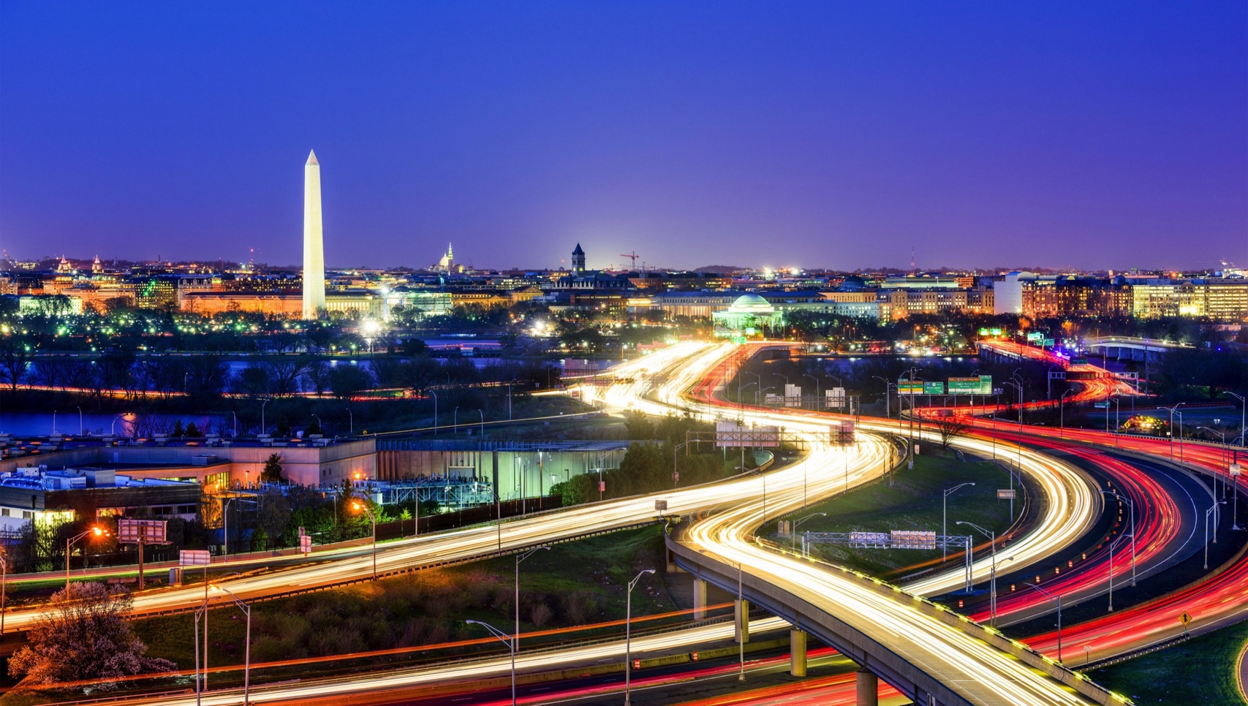
Thank you!

