Slide 1
Hospitals & Electrical Reliability
Chicago Advanced Energy Stakeholder Breakfast
Resiliency, Critical Infrastructure and Microgrids
March 1, 2018
York Chan, CHFM, CHC, SASHE
Vice President, Facilities Services
York.Chan@advocatehealth.com

Slide 2
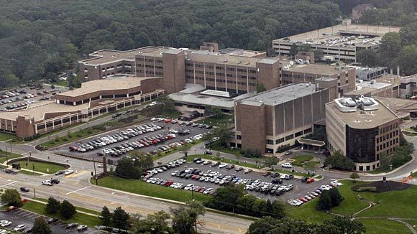
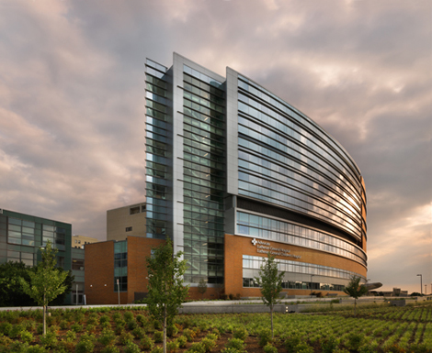
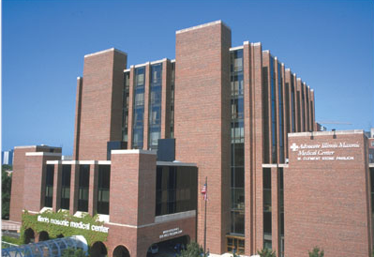
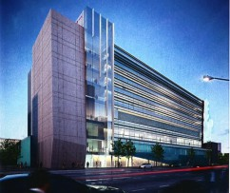
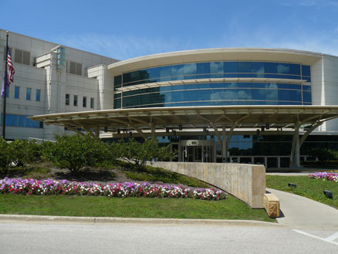
System of 12 acute care hospitals in Illinois
356 Sites of Care including 7 Trauma Centers
15 Million sq. ft. of healthcare occupancy
2017 – Energy Consumption
231.4 Million Kilowatt Hours of Electricity
12.2 Million Therms of Natural Gas
Sustainability and Energy Focus
Full time Sustainability Director and Manager
Full time Energy Manager
2.1% reduction in consumption from 2016 to 2017

Slide 3
Caring for Your Health & the Health of the Earth
"Advocate recognizes that sustaining the health of the environment is critical to preserving human health. With a deeply rooted commitment to our mission, values and philosophy, we are driven to be good stewards of all our resources, including the earth."
Jim Skogsbergh,
President and CEO Advocate Health Care

Slide 4
Hospitals & Electricity
Hospitals use 2.7 times more energy than a commercial office building
Average U. S. hospital consumes about 260,000 btu’s per square foot*
Average European hospital consumes about 150,000 btu’s per square foot
Hospitals are not in the power generation business – that is not our core function
A few have ventured into alternative and renewable energy sources
* US Dept. of Energy

Slide 5
Electrical Reliability
Number 1 concern for Healthcare Facility Managers is the lost of electricity!
Technology has advanced so much over the past decades in medicine and a majority of them are equipment related
Robotic surgeries
Remote diagnostics
Remote monitoring of patient vitals
Care of neonates
Heart/lung bypass machines
* US Dept. of Energy

Slide 6
Electrical Reliability
High tech equipment are very susceptible to power bumps, spikes and voltage fluctuations
A lot of equipment go into a self check mode, delaying restart for a period of time, thus jeopardizing life support
Building support equipment shut down and negatively impact environmental functions
Room pressurization relationships
Room temperature and humidity parameters
* US Dept. of Energy

Slide 7
Clinical Outcomes
Maintaining the “Environment of Care” is crucial to successful clinical outcomes
Air pressure differentials
Temperature/Humidity parameters
Air exchanges
Clinical outcomes impact how hospitals are paid
Patient satisfaction also impact financial reimbursements

Slide 8
Summary
Regardless of how a hospital is supplied electrically, whether from a micro grid or a traditional grid, the most important factor is the reliability and quality of the electrical feed!
* US Dept. of Energy

