Slide 1
AEG Chicago Forum May 28, 2020 Joe Dominguez CEO

Slide 2
Staying the Course for a Clean Energy Future and Strong Recovery from COVID-19
Planning is bringing the future into the present so that you can do something about it now.
We have the right plan in place:
Supporting our most vulnerable customers.
Working to improve our environment and achieve clean energy goals.
Delivering record levels of reliability and customer satisfaction.
Providing good-paying jobs, creating new opportunities, investing in the best and most diverse supply chain in the industry and training the workforce of the future.
Critical moments bring clouds or clarity. Never has the importance of the grid been more critical and the value of our plan more clear.
Clean and Affordable Power When We Need It
Lifting Up Communities in Need
Putting Our Clean Energy To Work
Smart Grid Investments
AFFORDABILITY
RELIABILTY
Culture
SAFETY
INTEGRITY

Slide 3
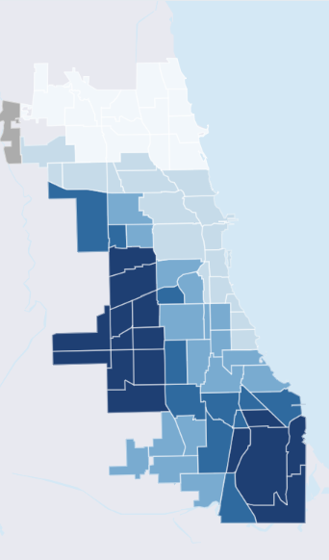
Stay-At-Home Orders Show Initial Progress but COVID Demonstrates the Cost of Local Air Pollution
Air Quality (left) and Map of COVID-19 Cases and Deaths by Zip Code (right)
Source: University of Chicago School of Public Health: Racial Inequality in the Distribution of COVID-19 Cases and Deaths in Chicago (2020)
Source: Respiratory Health Association (2020)

Slide 4
Illinois’ Clean Energy Advantage Positions the State To Meet the 2025 Paris Goals
Illinois is currently at roughly 85% progress towards the 2025 Paris emission goals (a 26-28% reduction off-of 2005 emissions) and is on pace to achieve those reductions by 2025.
85%
Source: US EIA
*Note: 2020 point is extrapolated from 2017 actual data and is adjusted for recent coal retirements.

Slide 5
Premature Clean Energy Retirements Would Crater Compliance
If all the non-FEJA clean energy plants in Illinois retire, the amount of hourly load matched with zero-emission generation drops from 92% to 19%, and roughly 66 TWH of zero-emission generation would be replaced by fossil generation.
20%
92%
85%
19%
*Note: 2020 point is extrapolated from 2017 actual data adjusted for recent coal retirements,
replacement generation emissions are estimated to be 0.6 mt/mwh.

Slide 6
ComEd Zone Hourly Energy Supply
5
Seasonal variation of existing wind and load results in exports of clean generation from ComEd in non-summer months today.
Wind Output 35 MW
Wind
Output 2,600 MW
Fossil
For Grid
Stability

Slide 7
ComEd Hourly Generation - 2030
6
Assuming a load-ratio split of the new renewable energy, the excess zero-emission generation in ComEd would be as high as 17 GW in some hours.
Existing net export capacity is approximately 6 GW.

Slide 8
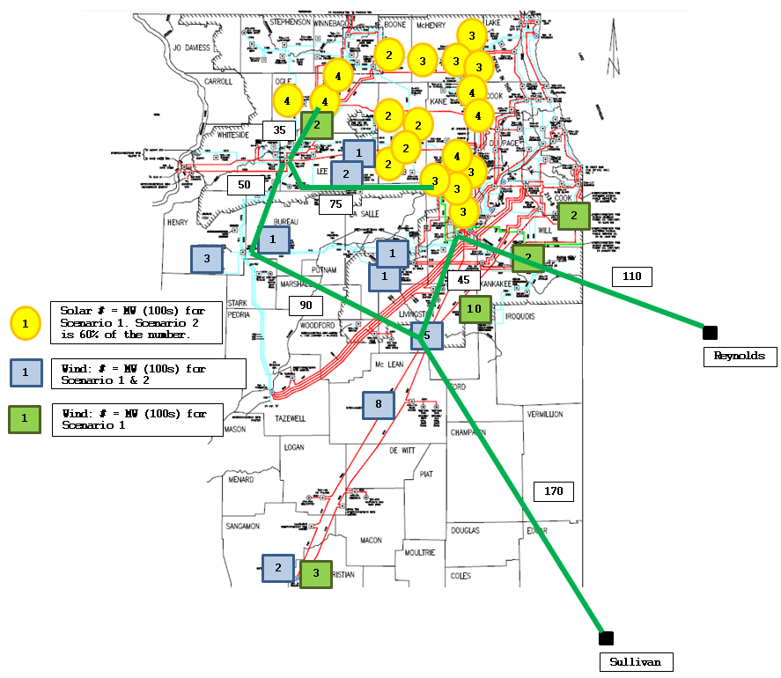
Transmission Cost Impacts of Legislative Proposals
7
Transmission Upgrades
New Transmission Costs
Transmission CapEx ($Billions) | CJC | PathTo100
Local Overloads | $1.0 to $1.5 | $0.8 to $1.3
Regional Overloads | $3.2 to $4.2 | $1.7 to $2.2
Total | $4.2 to $5.7 | $2.5 to $3.5

Slide 9
Coordinating Electric and Transportation Sector Policies Creates Over $35 Billion in Value for Illinois Families and Businesses
8
(15% Light-Duty
Electric Vehicles)
YIELDS
$2.6 Billion in Electrification Investments $36.1 Billion in Benefits
- Public/Fleet Charging Station Interconnection - $2 Billion in Avoided Transmission Costs
- Charging Rebates - $3.6 Billon in Incremental Avoided C0₂
- Public Transportation/School Bus Rebates - $6.5 Billion in Health Care Benefits
- Low Income Incentives - $24 Billion in Fuel Savings
- Beneficial Electrification Rebate
11-1 in “Wallet Share” Benefit/Costs

Slide 10
Problem Statement
Critical moments bring clouds or clarity. Never has the importance of clean air been more critical and the value of our goals more clear.
To achieve Chicagoland's clean energy goals and post COVID-19 recovery, we must accelerate the pace at which we build we build clean energy infrastructure. We cannot put on the shelf for a more convenient time the need to improve our environment. Covid-19 has laid bare the urgency.
Let’s seize the moment, scale-up and realize NOW the benefits of a clean energy future and ensure a sustainable recovery from COVID-19.

